Slide 1

Mexico City Mode comparison
Household Travel Survey Analysis
Zhanchao Yang
2007-2017

Slide 2
Single mode trip
77.59% (2007) vs 86.18% (2017)
Note: In 2017, walking was counted as a separate category. Walking + other modes is counted as “other” modes.
E.g., walking + driving = driving

Slide 3
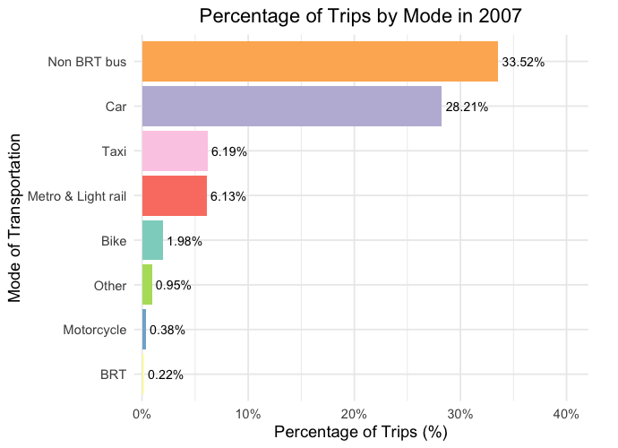
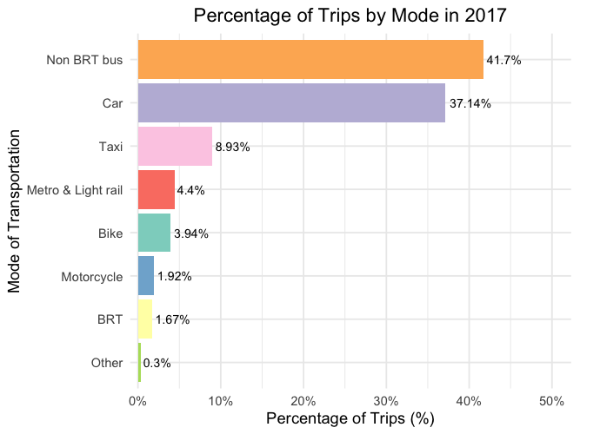
2007 vs 2017 single mode trip distribution

Slide 4
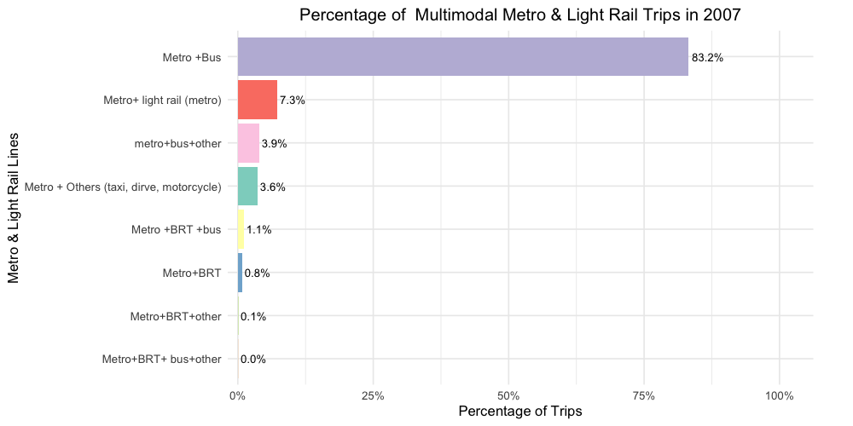
Single-trip Metro vs multimodal Metro (2007)
6.13% vs 19.67%

Slide 5
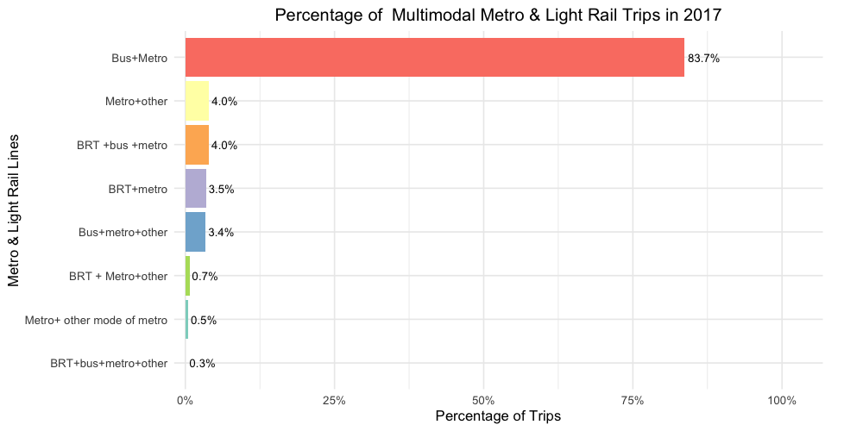
Single-trip Metro vs multimodal Metro (2017)
2.46% vs 10.64%

Slide 6
Metro multimodal trip comparison

Slide 7
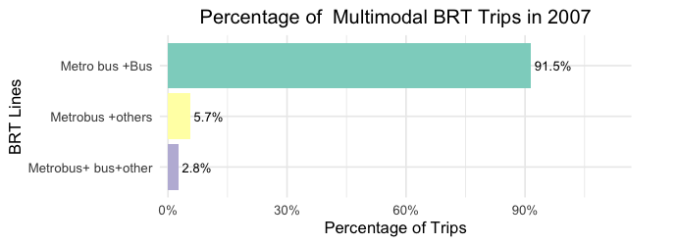
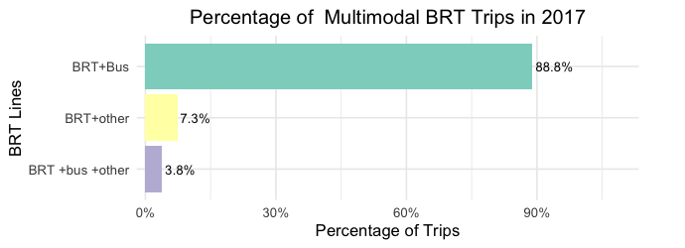
BRT (0.5% vs. 1.1%)

Slide 8
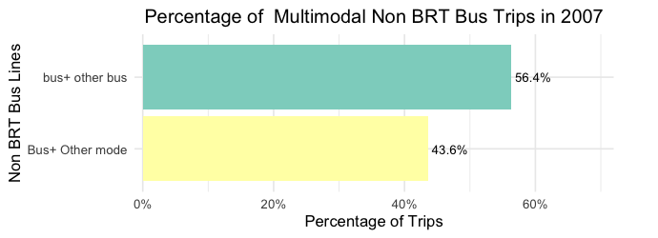
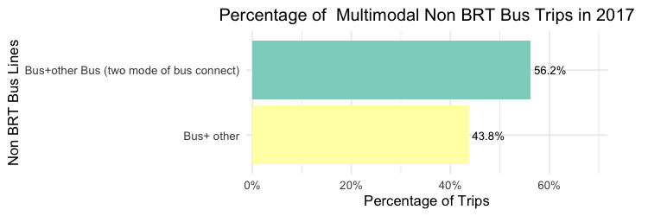
Bus (2.2%vs 1.95%)

Slide 9
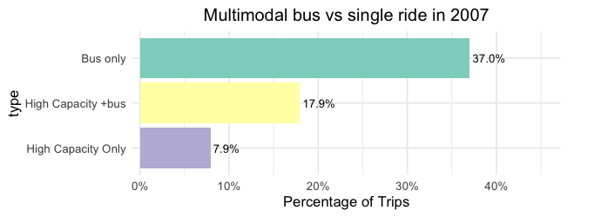
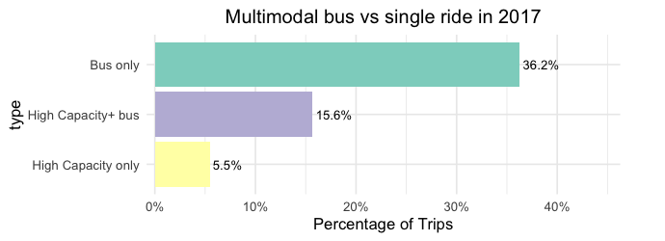
Bus only, High Capacity only, and bus +High Capacity

Slide 10
Weighted trip Analysis
Single-mode trips
76.68% (2007) vs 70.47% (2017, excluding walking)
76.68% (2007) vs 79.25% (2017, including walking)

Slide 11
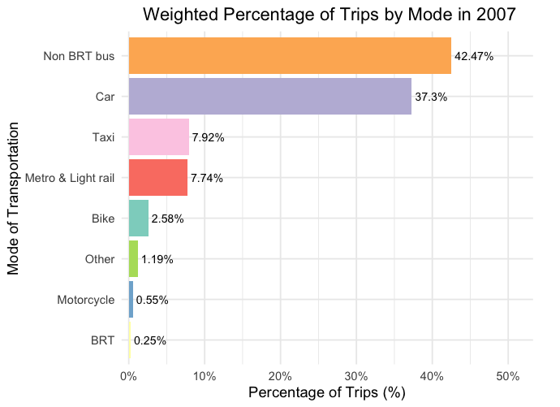
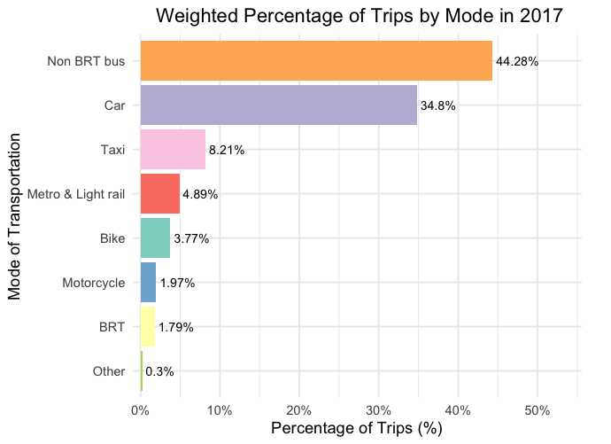
2007 vs 2017 single-mode weighted trip distribution

Slide 12
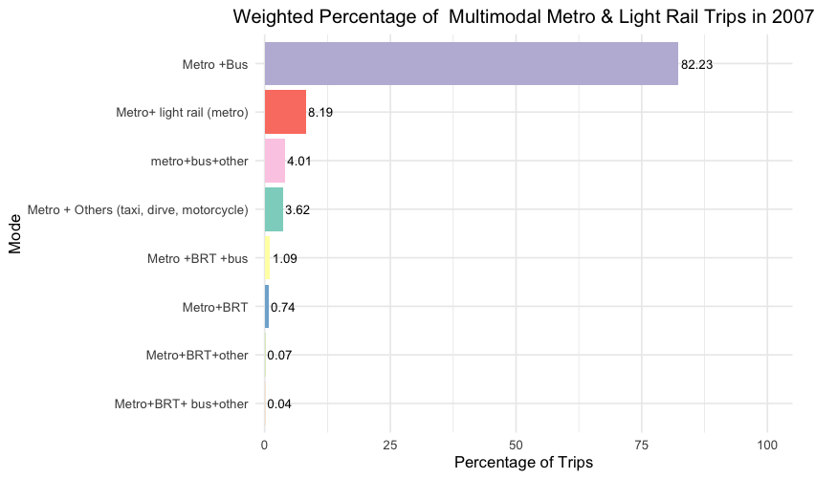
Single-trip Metro vs multimodal Metro (2007)
5.94% vs 19.66%

Slide 13
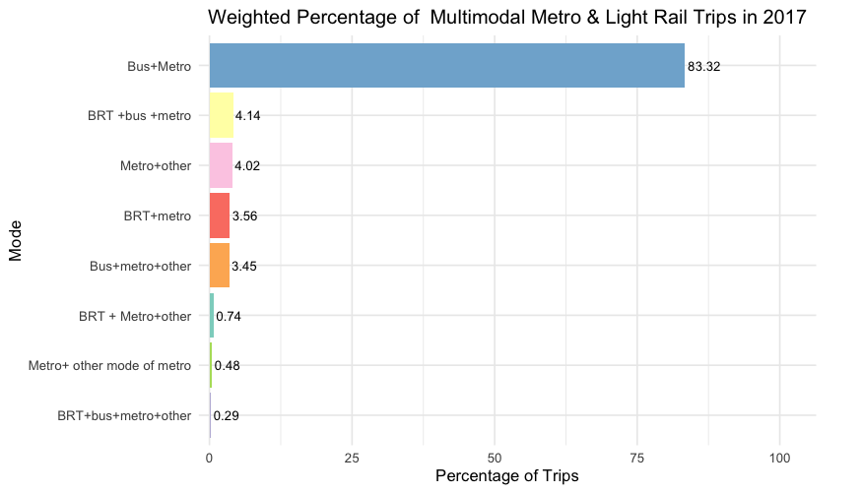
Single-trip Metro vs multimodal Metro (2017)
3.44% vs 22.71%

Slide 14
Metro multimodal trip comparison (weighted)

Slide 15
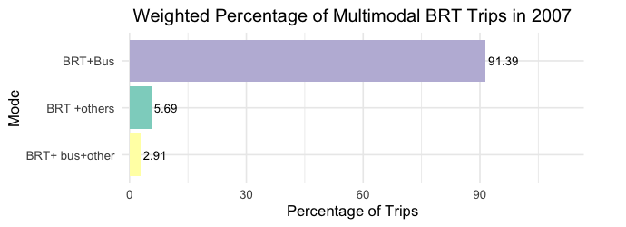
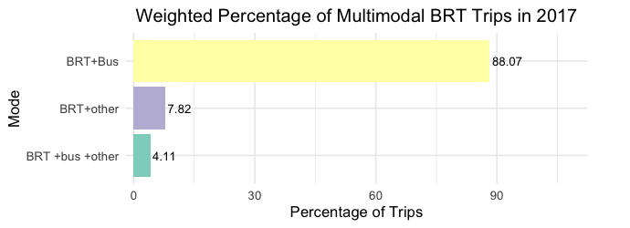
BRT

Slide 16
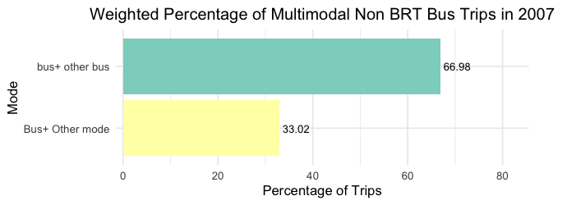
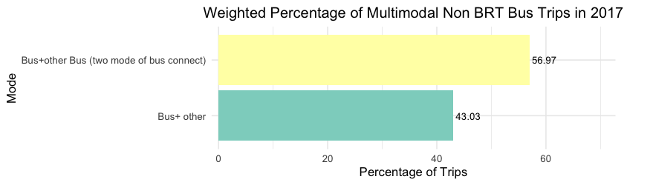
BUS

Slide 17
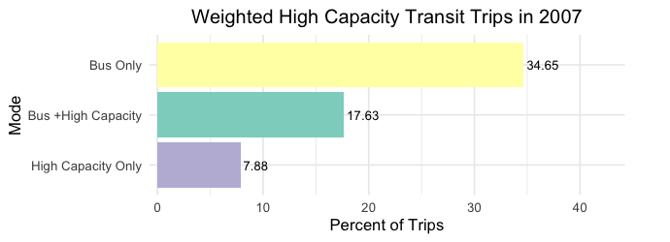
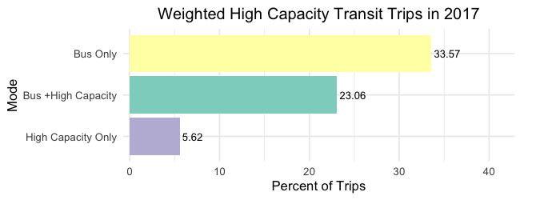
Bus only, High Capacity only, and bus +High Capacity

